Slide 1
Python debug configuration

Slide 2
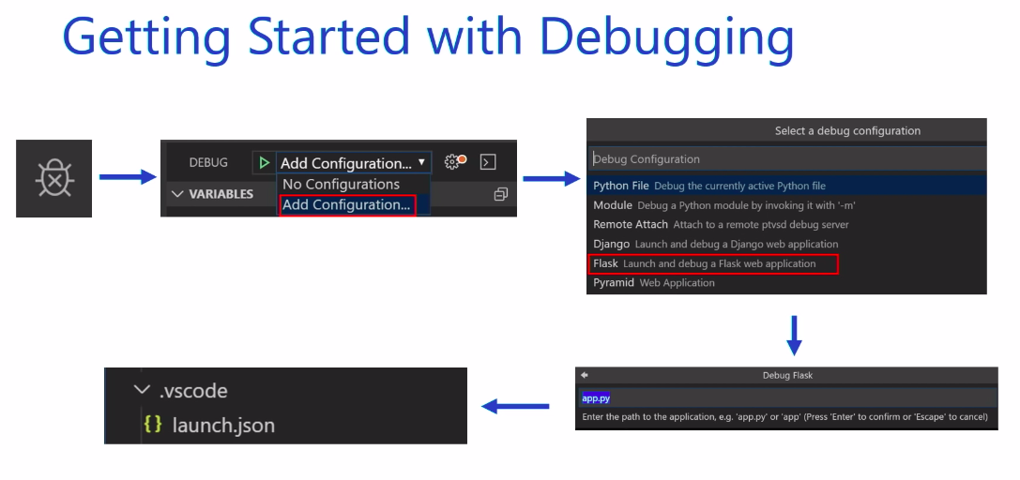
Add a debug configuration

